Slide 1

How to Evolve a Knowledge Graph?

Slide 2
Outline
Overview
Examples requiring Change
Change Management Techniques
Schema evolution
View maintenance
Truth Maintenance
Summary

Slide 3
Overview
Only constant in life is change
Change in the real-world
Change in the business requirements
Changes can require
Revising the schema
Revising the ground facts
Approaches to handle change must address
Technical challenges
Social challenges

Slide 4
Examples Requiring Change
Changing world
Changing requirements
Changing sources
Changes affecting previous inferences
Changes requiring redesign

Slide 5
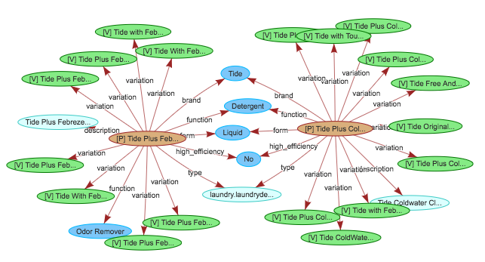
Examples Requiring Change
Changing world: Amazon Product Knowledge Graph
New products
New product categories
New features
Discontinued products

Slide 6

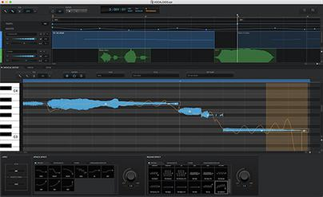
Examples Requiring Change
Changing requirements: Google Knowledge Graph
An artist must be a person
An artist must be a person OR a vocaloid

Slide 7
Examples Requiring Change
Changing sources (Google Knowledge Graph)
The artists of music albums are obtained from different sources
These sources keep changing their data feed
The sources used also change over a period of time

Slide 8
Examples Requiring Change
Changes affecting previous inferences
Consider the constraint that a movie theater only shows movies
Using this constraint a KG might have previously inferred that certain events are movies
More recently the movie theaters are being used for operas, and social events
If we had previously derived such events to be movies, we must update them

Slide 9
Examples Requiring Change
Changes requiring redesign
Initial design: Every company has a CEO. A CEO is represented by name.
CEO: Person
Company

Slide 10
Examples Requiring Change
Changes requiring redesign
Initial design: Every company has a CEO. A CEO is represented by name.
Revised design: Every company has a CEO. A CEO is represented by an object that can also record the duration for which the person was a CEO
CEO: Person
Company
name
Company
CEO
start_date
end_date

Slide 11
Outline
Overview
Examples requiring Change
Change Management Techniques
Schema evolution
View maintenance
Truth Maintenance
Summary

Slide 12
Schema Evolution
For a relational database
Adding/removing a column, renaming an attribute
Known as database reorganization

Slide 13
Schema Evolution
For a relational database
Adding/removing a column, renaming an attribute
Known as database reorganization
For a knowledge graph
Adding/removing a class
Adding/removing a superclass
Adding/removing a property
Adding/removing a constraint
Approach is to maintain invariants, and make system-specific decisions

Slide 14
Schema Evolution
Remove/rename a property
The change must be propagated through the graph
Generate a summary for review by the user

Slide 15
Schema Evolution
Add a class
By default, its parent is the system defined root class

Slide 16
Schema Evolution
Remove a class
What to do about its subclasses and instances
If its subclass has another parent, do nothing
Otherwise, make it a subclass of immediate parent
A more extreme step is to delete the subclasses and instances
A
B
D
C

Slide 17
Schema Evolution
Remove a class
What to do about its subclasses and instances
If its subclass has another parent, do nothing
Otherwise, make it a subclass of immediate parent
A more extreme step is to delete the subclasses and instances
A
A
B
D
D
C
C

Slide 18
Schema Evolution
Remove a class
What to do about its subclasses and instances
If its subclass has another parent, do nothing
Otherwise, make it a subclass of immediate parent
A more extreme step is to delete the subclasses and instances
A
A
A
B
D
D
B
C
C
C

Slide 19
Schema Evolution
Remove a class
What to do about its subclasses and instances
If its subclass has another parent, do nothing
Otherwise, make it a subclass of immediate parent
A more extreme step is to delete the subclasses and instances
A
A
A
A
B
D
D
B
C
C
C
C

Slide 20
Schema Evolution
Add a super class
How to handle redundant links?
How to handle cycles?
A
B
C

Slide 21
View Maintenance
A mechanism from databases to name a query
Query is defined with respect to one or more tables (known as base tables)
If we store the results of the query, the stored data is called materialized view
If the base data changes, the materialized view must be updated
Incremental view maintenance

Slide 22
View Maintenance
A mechanism from databases to name a query
Query is defined with respect to one or more tables (known as base tables)
If we store the results of the query, the stored data is called materialized view
If the base data changes, the materialized view must be updated
Incremental view maintenance
Use of view maintenance is not prevalent in current Knowledge Graph engines

Slide 23
Truth Maintenance
A mechanism from rule-based systems
Tracks how each conclusion was derived
A popular implementation: Justification based system
Each derived conclusion records the fact or rule that was used in derivation
Any time that fact or rule updates, the conclusion must be revised
Use of truth maintenance is not prevalent in current Knowledge Graph engines

Slide 24
Summary
Knowledge Graphs have a life-cycle
Must evolve over a period of time
Must address both social and technical concerns
Techniques and algorithms
Schema evolution
View maintenance
Truth maintenance

